Slide 1

The Story of the (English) Bible

Slide 2
“All Scripture is God-breathed.”
~ The Apostle Paul, 2 Timothy 3:16

Slide 3

The Original Documents
God – Exodus 24:12; 34:1; 34:28;
      Deut. 4:13; 5:22; 10:2,4
Moses – Exodus 17:14; 24:4; 34:27;
      Numbers 33:2; Deut. 31:9;
      Mark 10:5; Rom. 10:5
Joshua – Joshua 24:26
Samuel – 1 Samuel 10:25; 1 Chron. 29:29

Slide 4
The Original Documents
Ancient records – 1 Chronicles 4:22
Prophets/Seers – 1 Chronicles 29:29;
      2 Chron. 9:29; 12:15; 13:22; 32:32
      2 Chron. 35:25; Jer. 36; Hab. 2:2
Solomon – Prov. 22:30; Eccles. 12:10
Mordecai – Esther 9:20

Slide 5
The Original Documents
Old Testament Scriptures written between about 1400 BC (Moses) to about 400 BC (Malachi). Copies of the earlier writings were made throughout this time.
Job may have been written earlier than the Books of Moses according to many scholars.

Slide 6

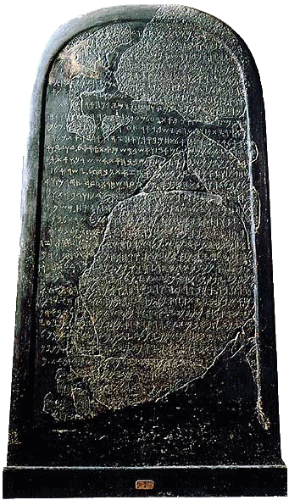
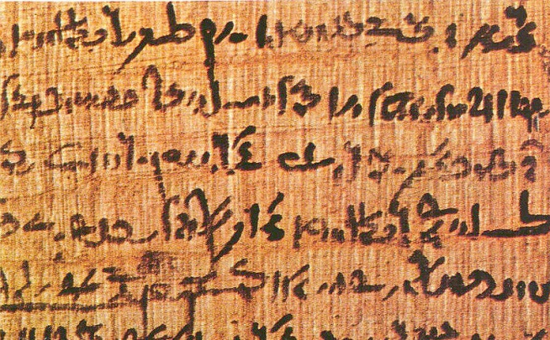
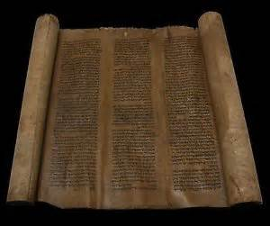
Papyrus
Vellum
Scroll
Stone

Slide 7
The Indispensable Scribes
Convinced that they were copying records of the very words and deeds of God, they reverently maintained a great accuracy, and strict guidelines were created and enforced.
We have found hundreds of copies of Old Testament passages from various time periods which, when compared, show a striking consistency and accuracy.

Slide 8
Septuagint (LXX or 70)
First Greek version of the Hebrew Torah (Pentateuch or Law of Moses), then other Old Testament texts and apocryphal texts.
Legend describes 72 Jewish scholars enlisted to translate Hebrew into Greek for the Alexandrian librarian Demetrius around 285 BC.

Slide 9
Septuagint (LXX or 70)
Koine Greek was the common language of the Greek and earlier Roman empires, while Hebrew had been replaced by Aramaic in common usage in Israel.
Quotations in the New Testament writings align more with Greek Old Testament translation.

Slide 10
New Testament Writings
Written from around early 50’s AD (Mark or letters of Paul) to, at the latest, mid-90’s AD (Revelation).
Most likely written on more accessible papyrus rather than more expensive vellum (animal skins).
Hebrews has the most questionable authorship.

Slide 11

Canons
The OT canon was in practical use before the time of Jesus’ mortal ministry, but it was officially ‘closed’ in 100 AD when an assembly of rabbis affirmed it in Jamnia, Israel.
The NT canon was in practical use by numerous churches and lists were set forth by various church leaders at different times, but it was officially considered orthodox for the Christian world in 397 AD by church leaders during the 8th Council of Carthage.

Slide 12
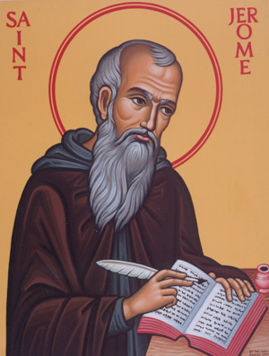
Vulgate
(Latin Translation)
Translation from the original languages into Latin, the common language of the time.
NT texts completed around 384 AD, and the OT texts (including Apocrypha) completed 405 AD.

Slide 13
Vulgate
(Latin Translation)
Accepted by Augustine and introduced to Western churches as the best Latin translation available.
Made the Scriptures accessible to the commoner. “Vulgate” is rooted in the world “vulgar”, which means “common”.

Slide 14
Vulgate
(Latin Translation)
Because of its accuracy, it became the only accepted translation of the Scriptures in the Roman Catholic Church. Despite its original purpose, its use was required even when/where Latin was not the common language.

Slide 15
Partial English Translations
Abbot Aldhelm (640-709)
  passages of the Psalms
Bishop Egbert (766)
  passages from the Gospels
Venerable Bede (674-735)
  dictated book of John
King Alfred (849-899)
  Commissioned translation of 10 commandments, Psalms, and portions
  of the Gospels

Slide 16
Partial English Translations
Aldred (mid 10th century)
  paraphrased Latin in current dialect
Aelfric (1000)
  Genesis through Judges, and Job
Orm (1200)
  paraphrased parts of the Gospels

Slide 17
Partial English Translations
William of Shoreham (1320)
  Psalms
Richard Rolle (1340)
  Psalms with commentary

Slide 18
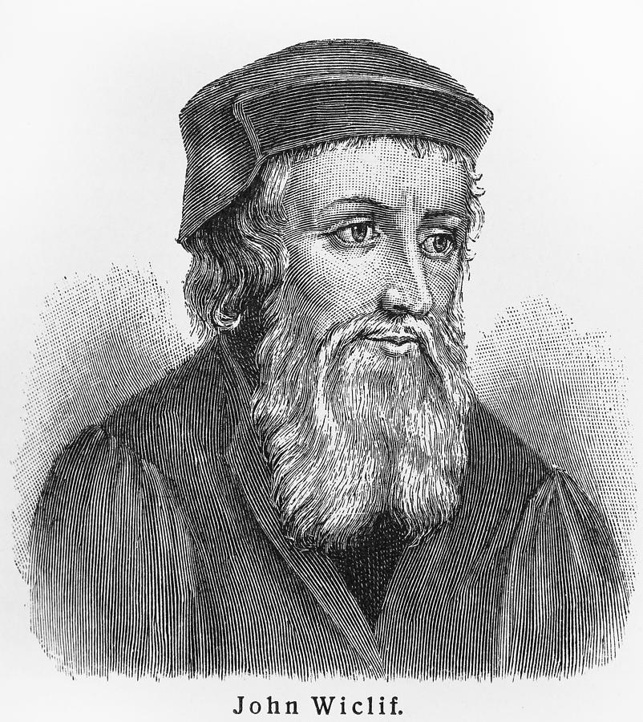
Complete English Translations
Wycliffe and the “Lollards” (1382)
  From the Latin Vulgate; Wycliffe died before its completion.
  Friend John Purvey revised it in 1396, and this edition had “enormous influence”.

Slide 19
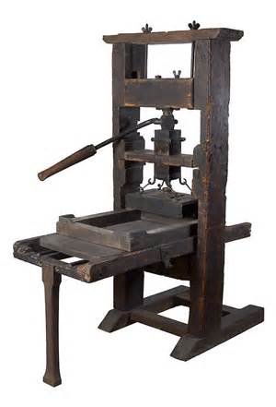
Complete English Translations
Printing press invented by Gutenberg (around 1439)
  Still laborious and expensive, but much faster than hand copying
  Printed Bibles of 1,282 pages on cloth paper and vellum
  Revolutionized communication

Slide 20
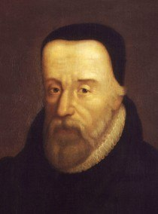
Complete English Translations
Tyndale – NT (1525)
  From Hebrew & Greek manuscripts
  Had to move to Germany to do the work
  Died before completion of OT; entrusted manuscripts to John Rogers

Slide 21
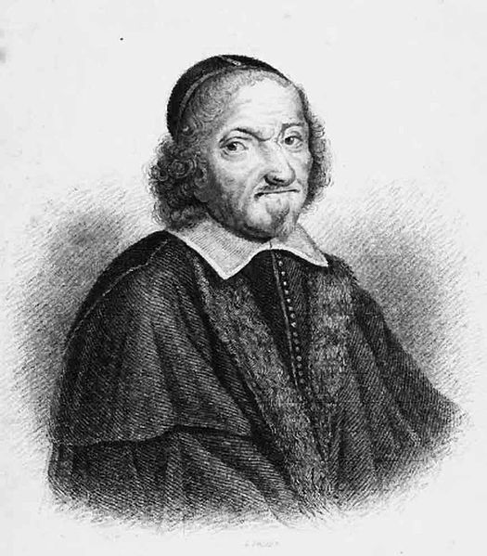
Complete English Translations
Coverdale Bible (1535)
  From Hebrew & Greek manuscripts
  Worked alongside Tyndale
  First complete English Bible to be printed on a press
  Moved the Apocrypha to the end of the OT

Slide 22
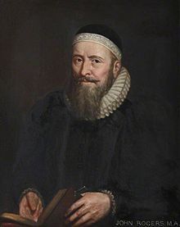
Complete English Translations
Matthew’s Bible (1537)
  John Rogers’ work under the pen name “Thomas Matthew”
  Combined Coverdale’s OT with Tyndale’s NT
  Added about 2000 notes
  Known as “Wife-Beater’s Bible” because of note on 1 Pt . 3:7
  Authorized for printing by King Henry VIII

Slide 23
Complete English Translations
The Geneva Bible (1560)
  Work of several exiled scholars, including Coverdale, Calvin, and Knox.
  Published in small size for personal use rather than public reading; household Bible
  Known as “Breeches Bible” (Genesis 3:7)
  Used by Puritans and Pilgrim Fathers

Slide 24
Complete English Translations
King James Version (1611)
  King James VI appointed a team of 54 men to work under the Bishop of London, Richard Bancroft; committees and reviews
  Relied heavily on Tyndale’s translation
  Considered best translation up to that time
  Language influence by the poetry of the Elizabethan Age

Slide 25
Complete English Translations
English Revised Version (1881)
  British committee of 65 and American committee of 34
  Initially very successful
  American committee later published American Revised Version (1898)
  American Standard Revised Version followed in 1901

